Slide 1

PREDICTION TO SUBSCRIBE FOR A TERM DEPOSIT
Group No : 12
Mentor : Saurabh Reddy
Team Members:
Diksha G Nayak
Gifty Maria Paul
Navaneet Sankhala
Sai Nithil Gopu
Sameer Mannur

Slide 2
Brief Overview
A Term deposit is a type of fixed term investment value. Term deposits are a major source of income for a bank. A term deposit is a cash investment held at a financial institution. Your money is invested for an agreed rate of interest over a fixed amount of time, or term. The bank has various outreach plans to sell term deposits to their customers such as email marketing, advertisements, telephonic marketing, and digital marketing.
We are an in-house analytics team at this leading bank, tasked with better understanding of the direct marketing campaigns of a Portuguese banking institution.

Slide 3
Project Objective
Business Problem Understanding: Telephonic marketing campaigns are one of the most effective ways to reach out to people. However, they require huge investment as large call centres are hired to actually execute these campaigns. Hence, it is crucial to identify the customers most likely to convert beforehand so that they can be specifically targeted via call.
Business Objective: The data is related to the direct marketing campaigns of a Portuguese banking institution. The marketing campaigns were based on phone calls. Often, more than one contact to the same client was required, in order to access if the product (bank term deposit) would be ('yes') or not ('no') subscribed by the customer or not.

Slide 4
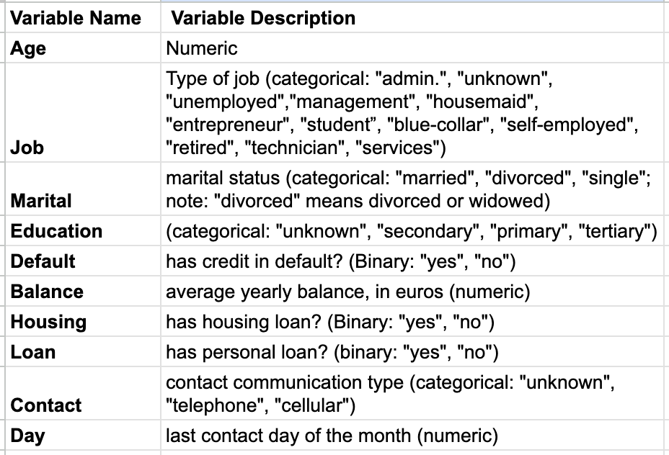
Dataset Information
No. of features: 17
No. of records: 45211
Target Column: Y
No. categorical columns : 9
No. Numerical columns : 8
Redundant columns :All our columns are useful.

Slide 5

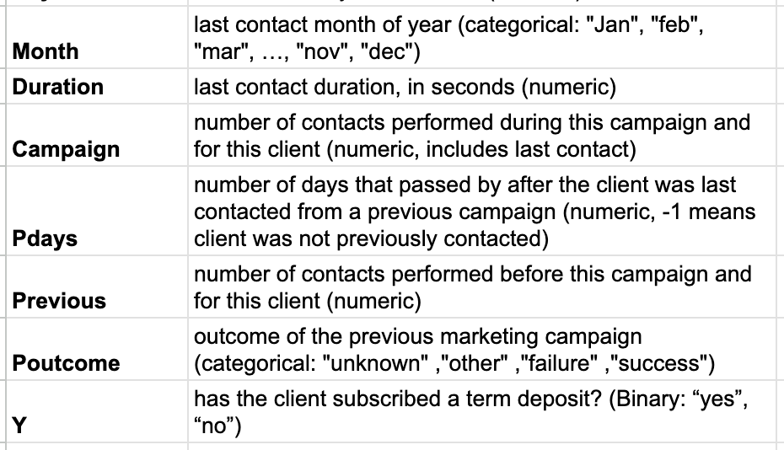
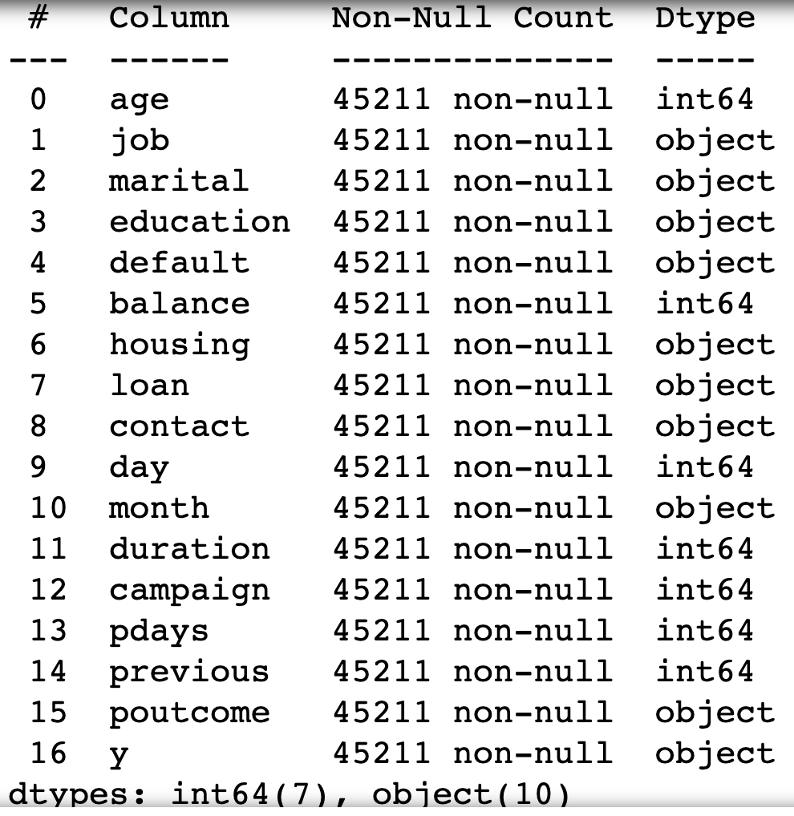

Slide 6
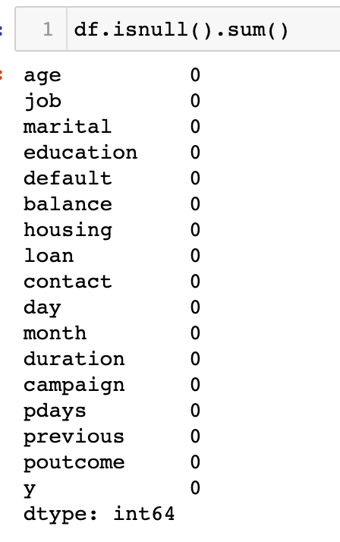
Exploratory Data Analysis (EDA)
Missing Values
No Missing values.

Slide 7
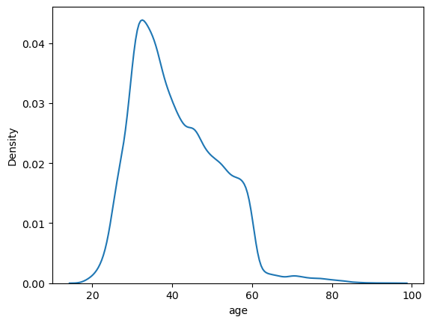
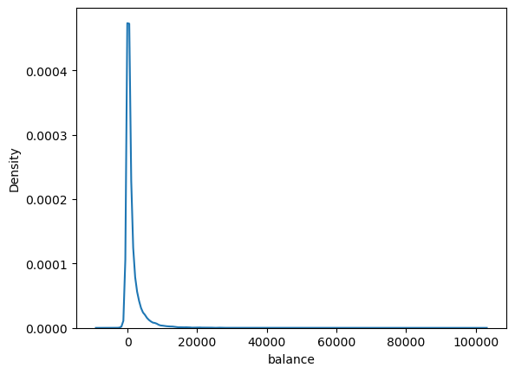
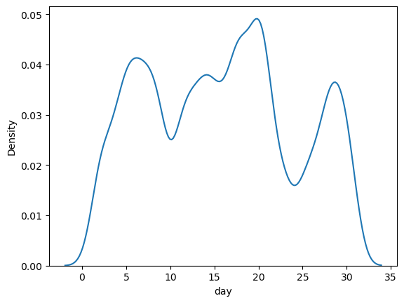
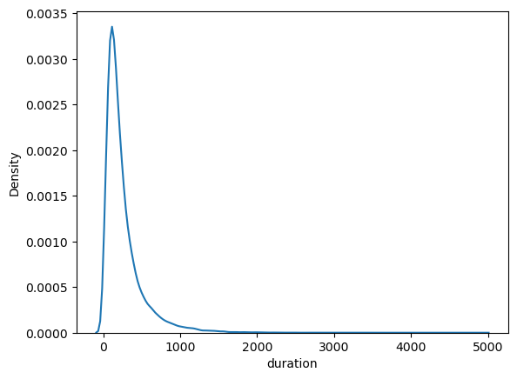
Univariate Analysis

Slide 8
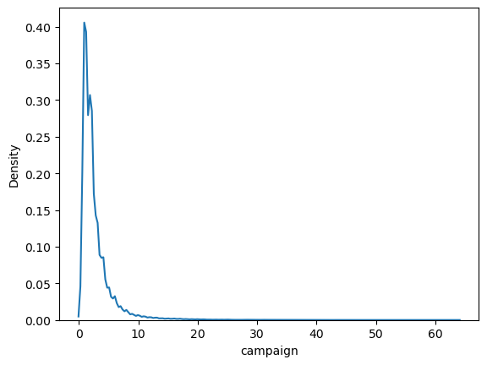
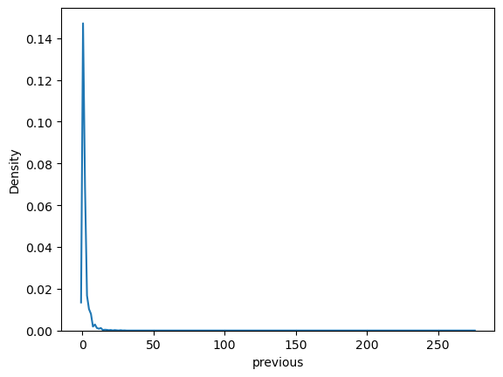
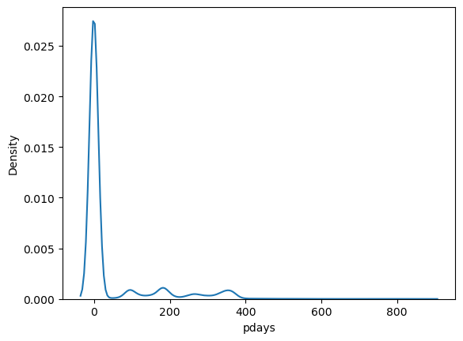

Slide 9
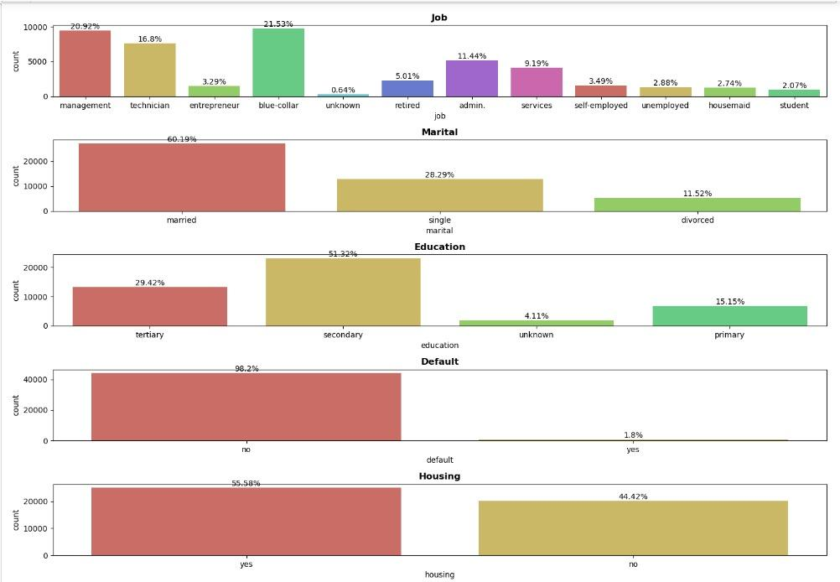
Performing univariate analysis on categorical variables.
We had performed similar count plot for all the categorical Variable.

Slide 10
INFERENCE
1) Over 99.36% of people having bank account are having job in different different sector.
2) More than 95% of people are Educated.
3) More than 55.58% of people are having a housing loan.
4) More than 83.98% of people are having loan.
5) Around 42.13% of the people belong to 36-50 age group

Slide 11
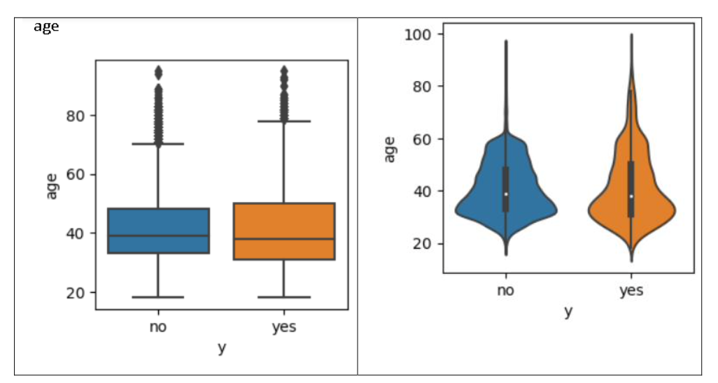
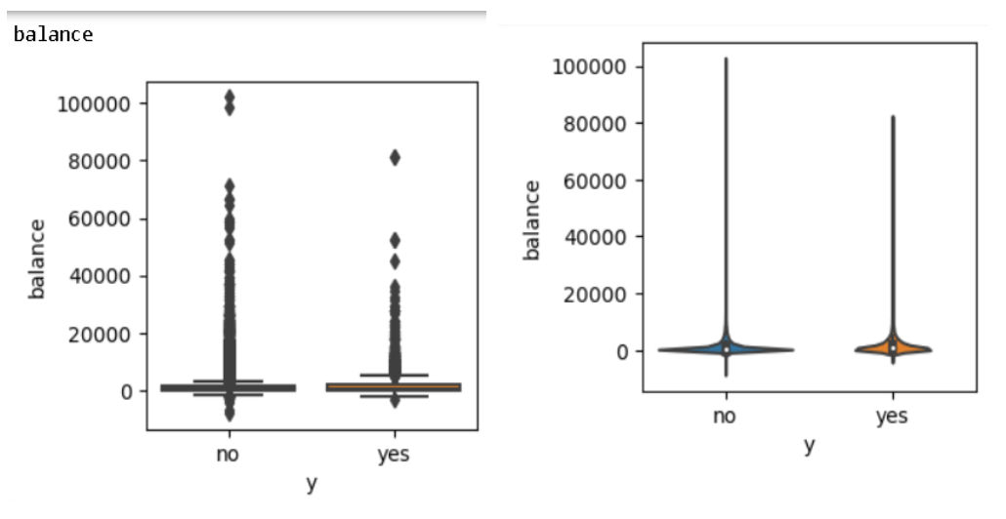
Bivariate Analysis
Here we will attempt to understand how the available columns are impacting each other on a one-to-one basis.
First, we visualise the relationship between our target column (Y) and numerical features (age,balance,day,duration,campaign,pdays,previous).

Slide 12
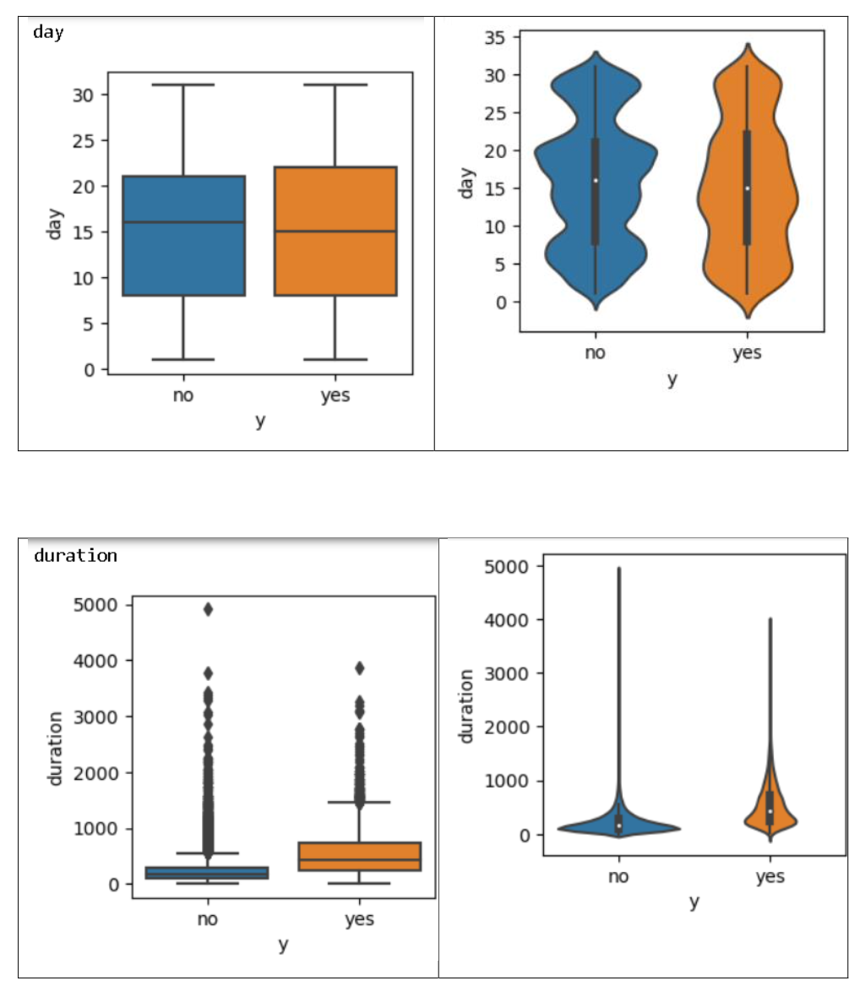
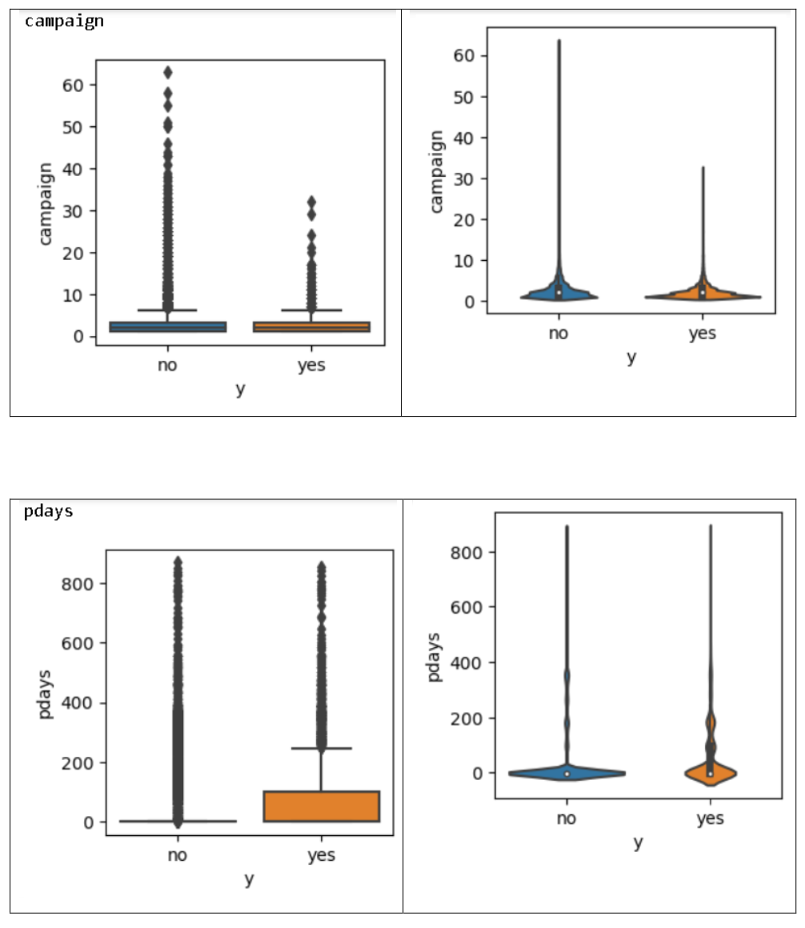

Slide 13
OBSERVATION:
Chi-square test was done for all the features to check whether the particular variable is significant or not.
H0: The variables are independent
H1: The variables are not independent
If the p-value less than 0.05, reject the null hypothesis, which means that particular variable is dependent to our target variable.
Here we are assuming 95% of confidence level.

Slide 14
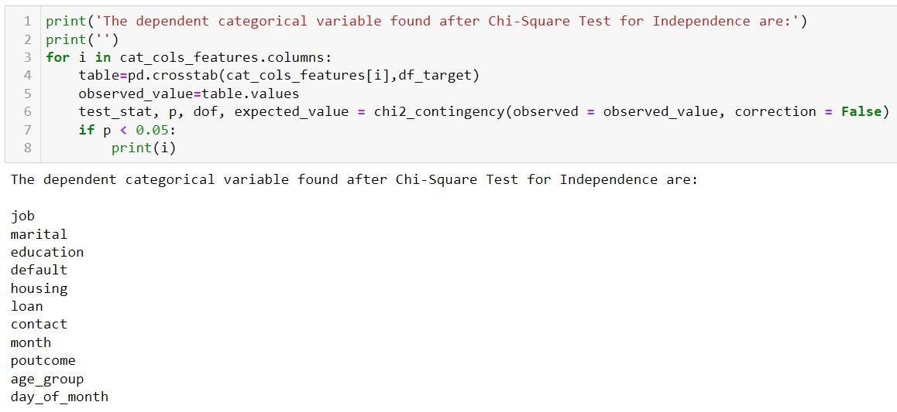
Checking for dependent categorical Variable using chi-square test

Slide 15
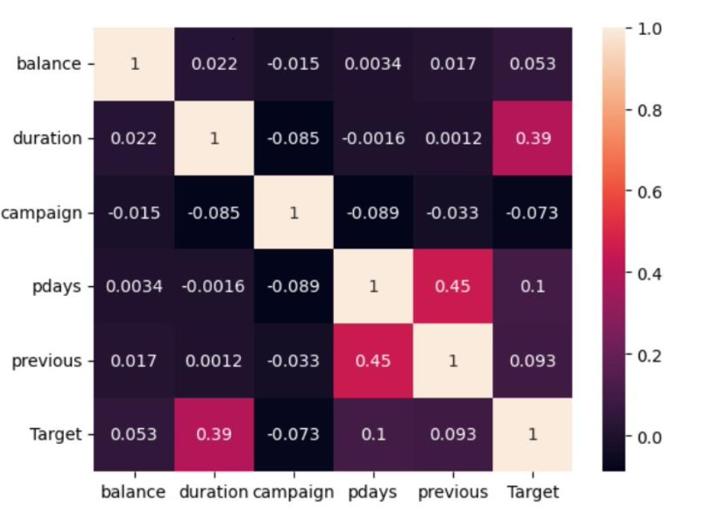
Multivariate Analysis
From our heatmap we can understand that there is no high correlation between our numerical variables. We can see that duration is the only variable which is a little correlated with our Target variable
There exists very little multicollinearity between the variables pdays and previous, which is very negligible. Rest no other independent variables is exhibiting multicollinearity.

Slide 16
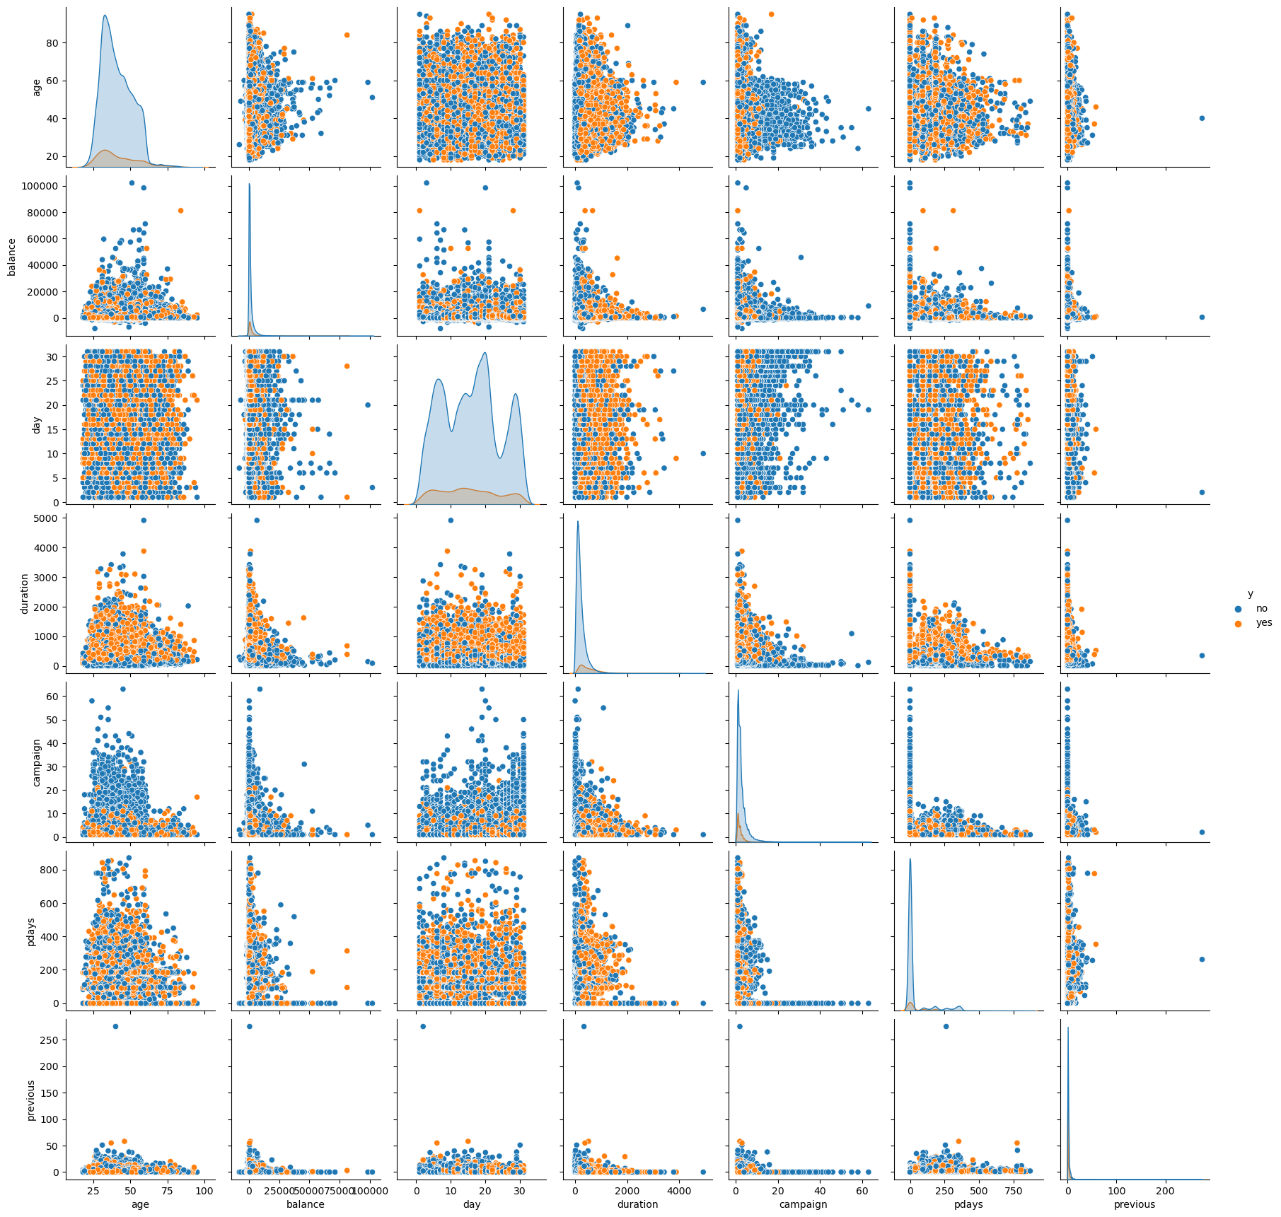
Inference we get from pair plot is that:
We can observe correlations between features and the target variable based on patterns and trends in the scatter plots.
Outliers can be identified as data points deviating significantly from the overall pattern.

Slide 17
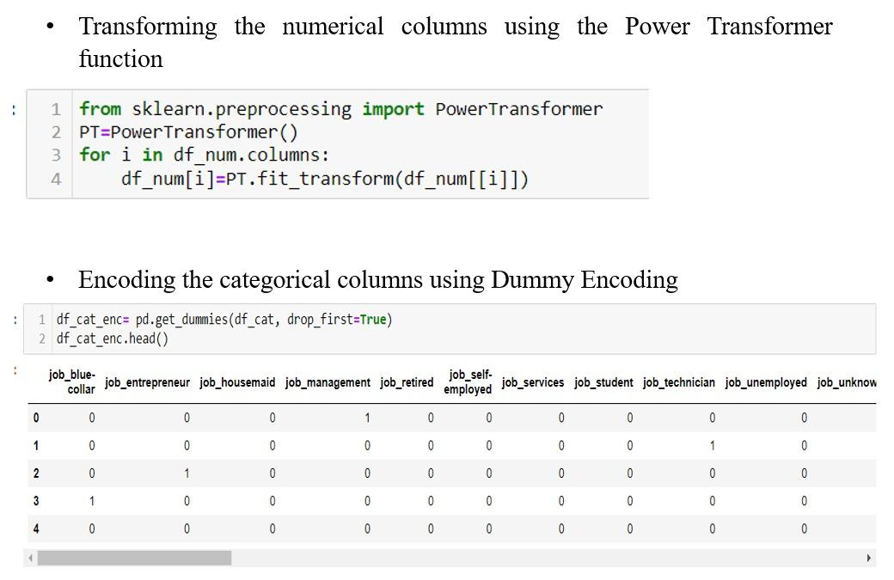
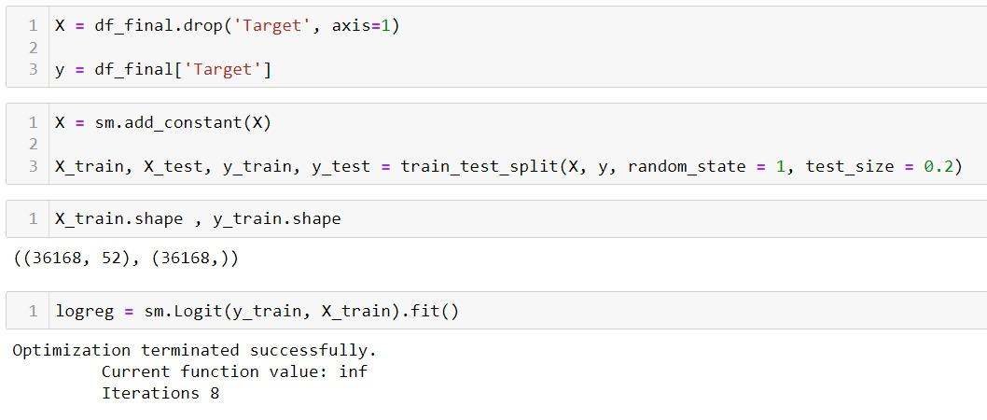
Base Model
Using Logistic Regression, we built the base model.
After performing transformation, scaling and encoding, we split the data into train test.

Slide 18
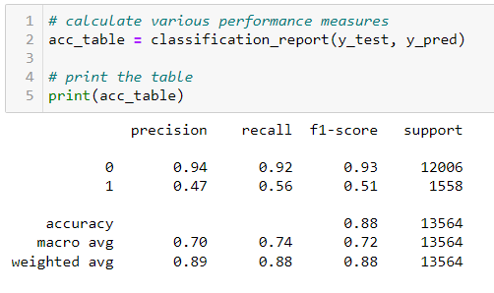
Classification Report
Testing Data
We can infer that the recall of the positive class is known as sensitivity and the recall of the negative class is specificity.
We can also compare using our test data performance.
The Accuracy of model is 0.88

Slide 19
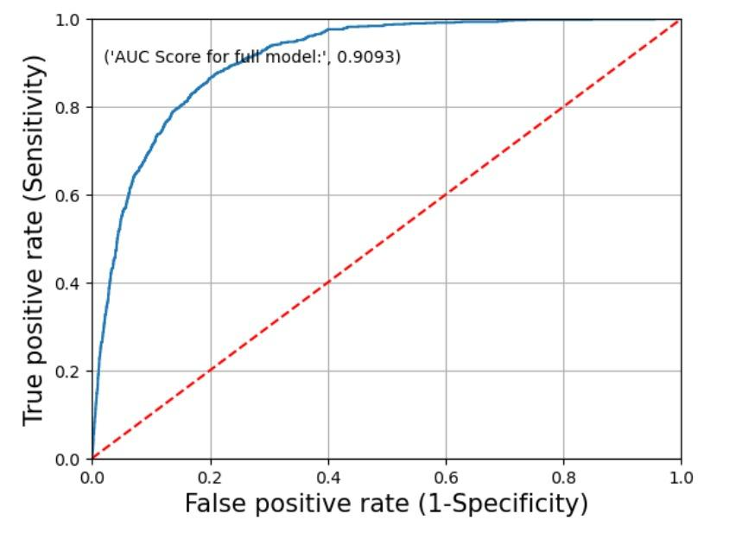
ROC Curve
The red dotted line represents the ROC curve of a pure random classifier. A good classifier stays as far away from that line as possible (towards top-left corner).
From the above plot, we can see that the classifier (logistic regression) is away from the dotted line; with the AUC score 0.9093.

Slide 20
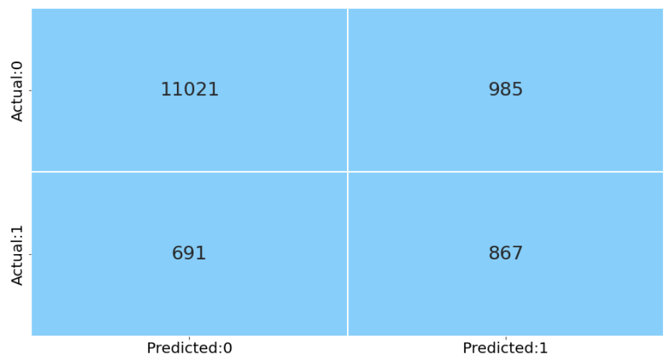
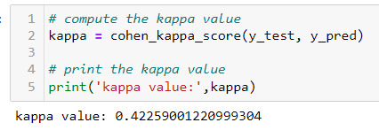
Confusion Matrix
In this confusion matrix, there are a total of 35,481 samples.
The true negatives (TN) are 11,693.
The false negatives (FN) are 982.
The true positives (TP) are 576.
The false positives (FP) are 313.
Kaapa Score
In this case, the kappa value is 0.422, which indicates
moderate agreement between the predicted and actual classifications.
This means that the model's predictions are not that good and
there is still some room for improvement in its performance.

Slide 21
So as to get better prediction we tried building different
Models such as:
Decision Tree
Random Forest
KNN model
Naïve Baye’s
And also we built Boosting Models such as:
AdaBoost
Gradient Boosting
XGBoost

Slide 22
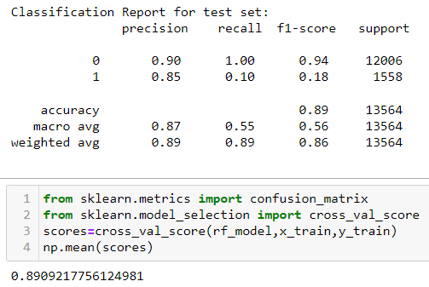
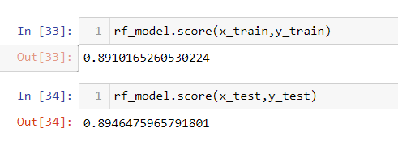
HYPERPARAMETER TUNING
For Random Forest :
Using these Parameters and building the model again and we got these scores:

Slide 23
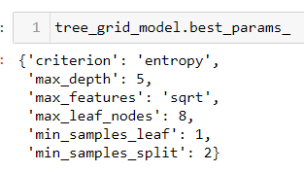
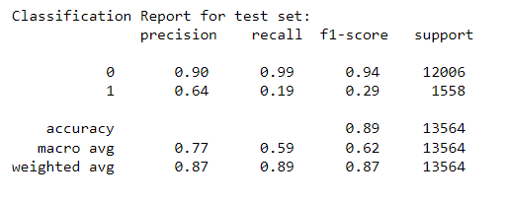
HYPERPARAMETER TUNING
For Decision Tree:
Using these Parameters when building the model again and we got these scores:
We got an overall accuracy of 89% using Decision Tree.

Slide 24
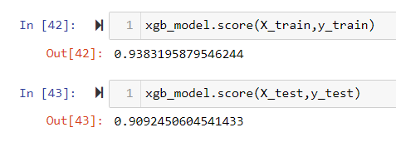
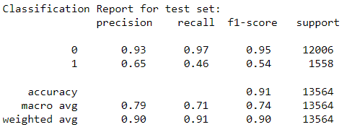
HYPERPARAMETER TUNING
For XGBoost:
Using these Parameters when building the model again and we got these scores:

Slide 25
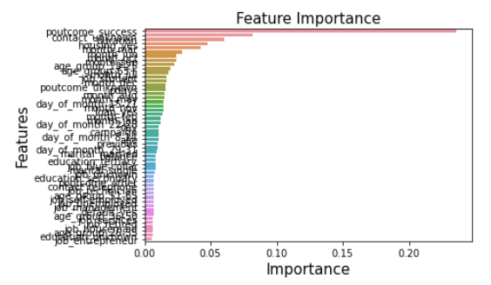
Selecting the best Features
The most important feature for the model is ‘poutcome_success’
which has an importance score of 0.2202.
The next most important features are “contact_unknown"
with importance scores of 0.1121.
The least important features are “job_entreptenure",
“education_unknown“ all with importance scores less than 0.0001.

Slide 26
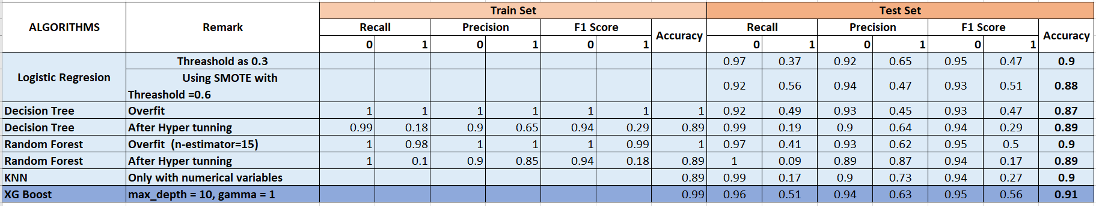
Comparing different Models.

Slide 27

Conclusion:
XGBoost and RandomForestmodel are the best performing models for Term-Deposit prediction, based on their high accuracy, recall, precision, F1, and kappa scores.
Decision Tree and Gradient Boosting models also show good performance.
KNN, Naïve Bay’s AdaBoost, and logistic regression models have lower performance compared to the top-performing models.
Future Action:
We would like to extend the project by retaining the customers for subscribing to the term deposit. By identifying the features which contribute the most and how we can improve any of the factor with respect to business perspective.

Slide 28
THANKYOU

